Slide 1

Department of Electronics & Communication Engineering
Mini-Project ( 18ECMP68 ) Presentation
on
“SENSOR DOORBELL”
Project Associates
Abhinandan k (4GM20EC001)
Basavaraj A S (4GM20EC018)
Danesh S A (4GM20EC025)
Likhith G K (4GM20EC054)
Project Guide
Mrs. Revathi S N
Asst. Professor

Slide 2
Contents
Abstract
Introduction
Objectives
Literature survey
Methodology
Components required
Applications
Results
References

Slide 3
Abstract
Doorbells are usual signaling devices used to alert the person inside the building .
Classic doorbells can be seen in every house now days, which uses simple button .
IR sensors are used for detect the motion of the person .

Slide 4
Introduction
This project can be really beneficial because it’s not always the case that a person can reach the doorbell.
It will detect someone in front of it and then it will ring.
IR sensors are used for motion detection without physical contact for small distances.

Slide 5
Objectives
It enables the users to monitor visitors in real time.
To avoid contact while pressing doorbell.
To use wireless and touchless doorbell for safety purpose.

Slide 6
Literature survey
Author | Title | Year of Publication | Remarks
Ahmed Salad, Ahmed Muktar, AbdulAziz Ahmed. | “A Framework for Wireless Doorbell System with Object Detection” | July 2017 | This framework is used for detection of wireless Doorbell
Johnson, A., Smith, B., & Williams C | “Smart Home Doorbell with Sensor Technology for Enhanced Security” | 2018 | In this study, the authors propose a sensor doorbell system that utilizes motion sensors
2

Slide 7
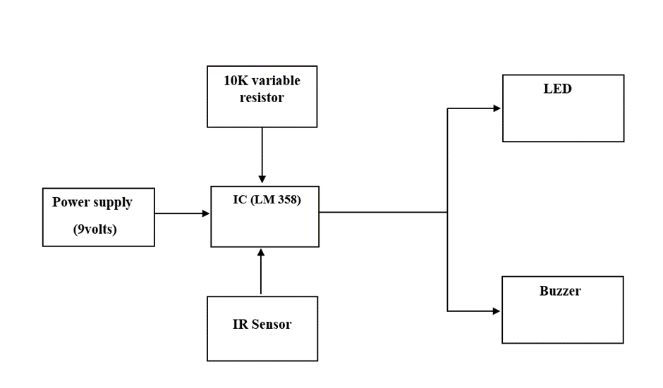
Methodology

Slide 8
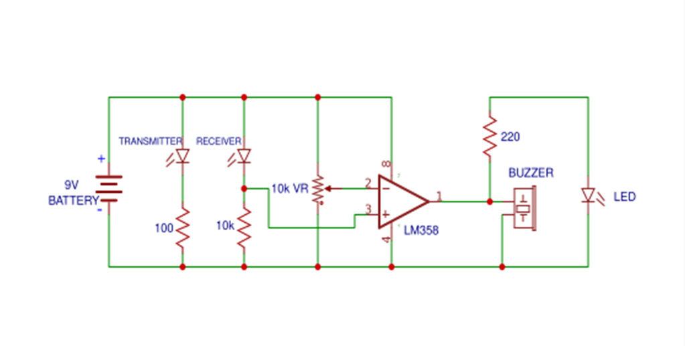



Schematic diagram

Slide 9
Components requirement
Zero PCB
IR Rx Tx (sensor)
LM358 (IC)
Led
Buzzer
Resistors (10k variable resistor, 10k , 1k (2))
Supply Voltage

Slide 10
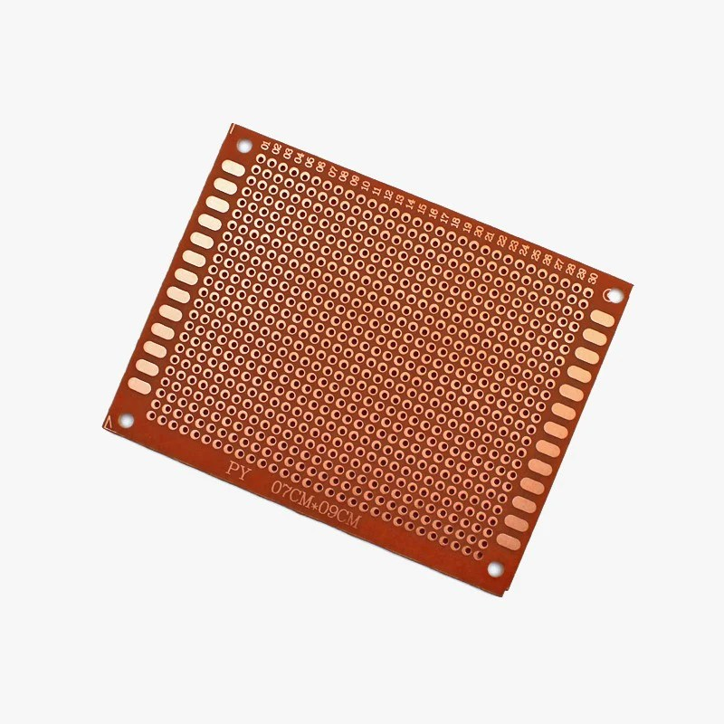
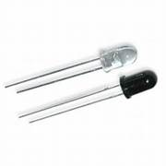
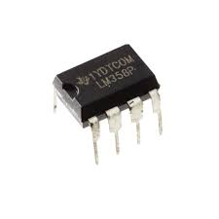
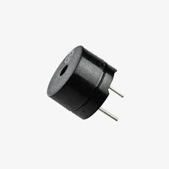
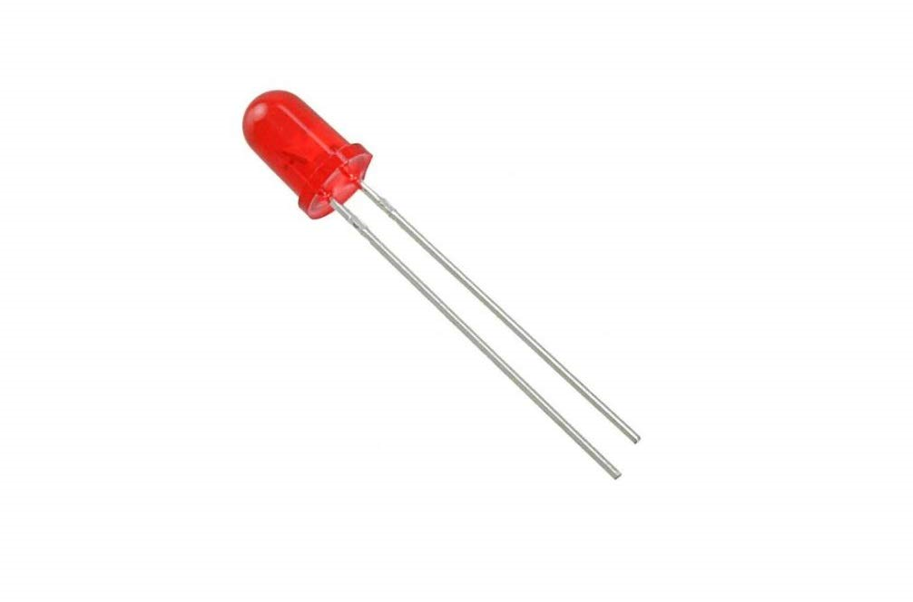
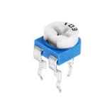
1)Zero PCB 2) IR Rx Tx 3) LM358 (IC)
4) Buzzer 5) LED 6) 10k Variable Resistor
Figure 1: Zero PCB
Figure 2: IR Rx Tx
Figure 3: LM358
Figure 4: Buzzer
Figure 5: LED
Figure 6: 10k Variable Resistor

Slide 11
Applications
.The Wireless Doorbell implemented in this project is just a demonstration of the idea. But the idea can be extended to actual, real time wireless doorbell system.
.The project is suitable for homes, shops, garages, hospitals, offices etc.

Slide 12
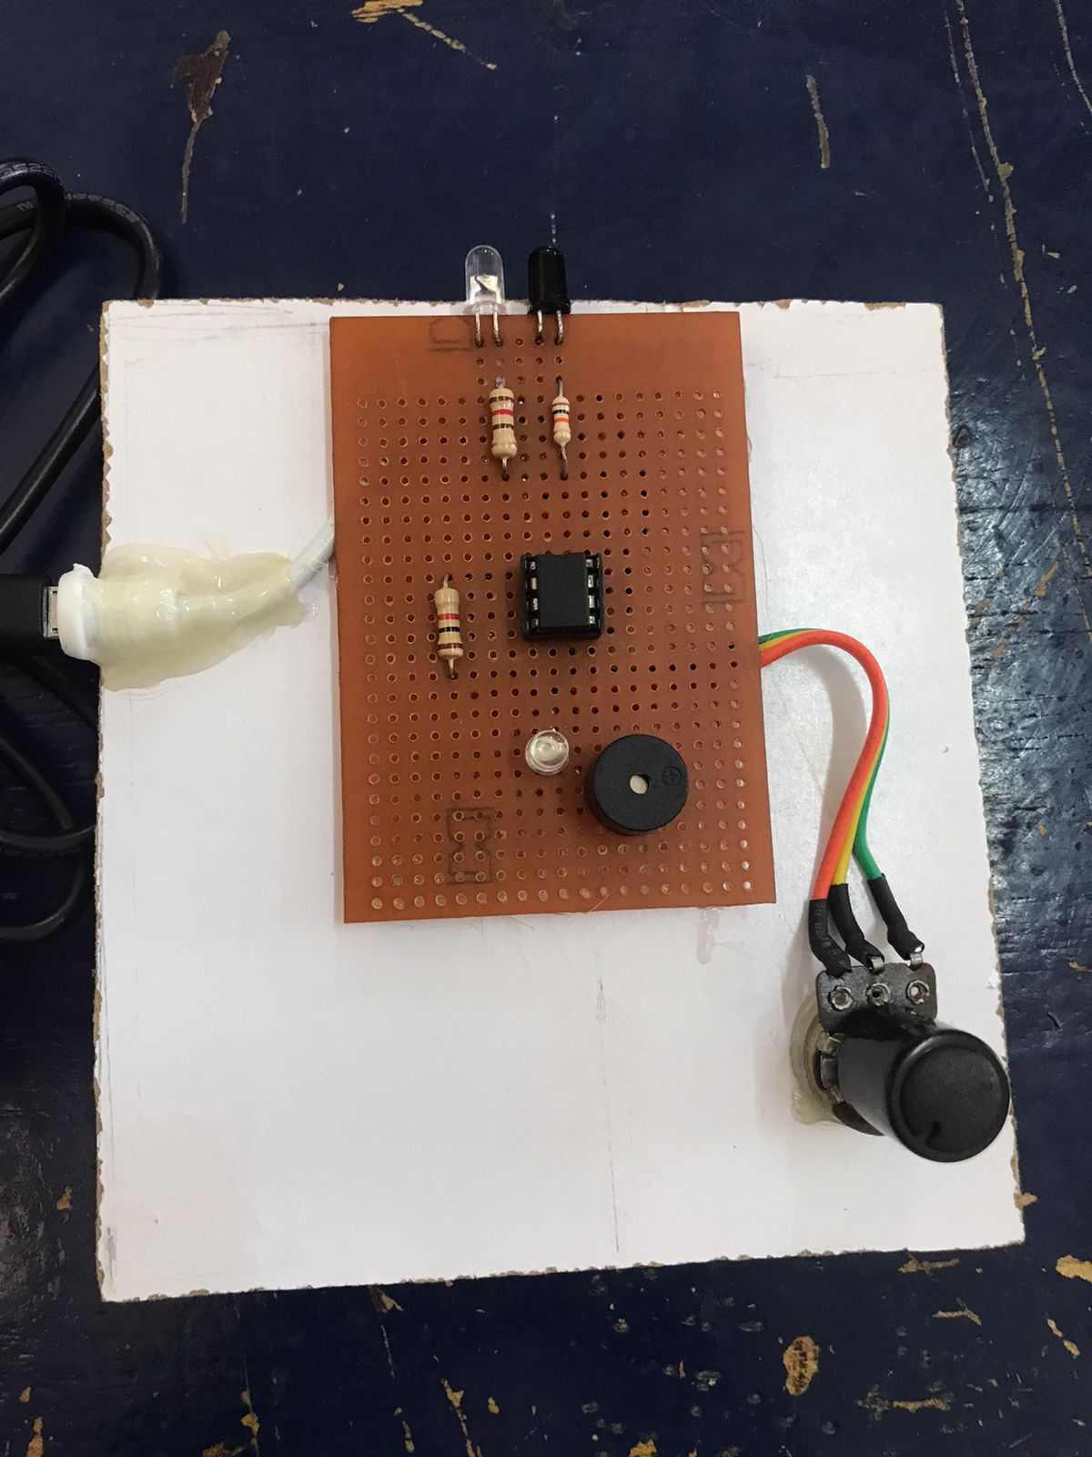
Results
Figure 7: Snapshot of prototype

Slide 13
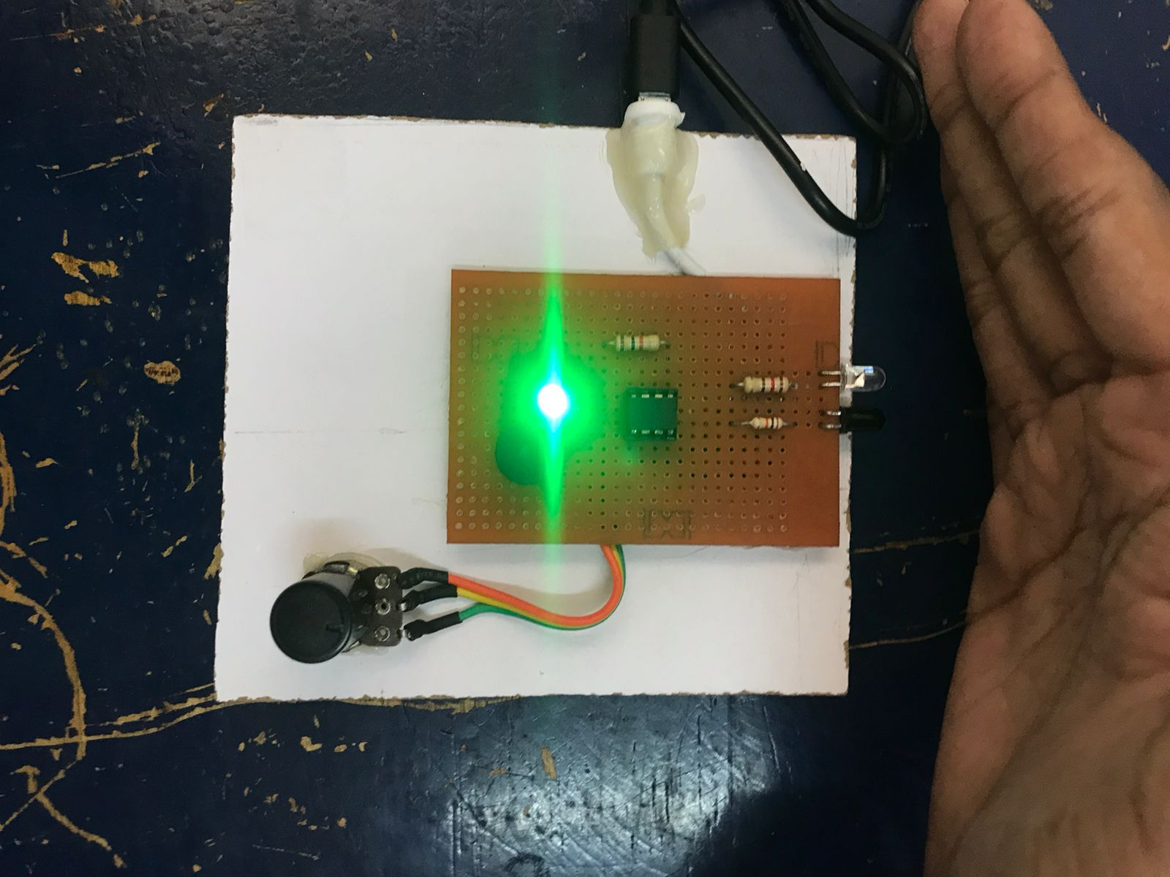
Results
Figure 8: Final output

Slide 14
References
[1] Ahmed Salad, Ahmed Muktar, AbdulAziz Ahmed, “A Framework for Wireless Doorbell System with Object Detection”. SOMALI JOURNAL OF ENGINEERING AND SCIENCE Vol.2, Issue 1, July 2017.
[2] Johnson, A., Smith, B., & Williams C , "Smart Home Doorbell with Sensor Technology for Enhanced Security" Published on 2018.

Slide 15
THANK
YOU

